Slide 1

Note: The data and information in this document is reflective of a hypothetical situation and client. This document is to be used for KPMG Virtual Internship purposes only.
Sprocket Central Pty Ltd
Data analytics approach
Divya Pardeshi
Data Analytics Consulting Virtual Intern

Slide 2
Note: The data and information in this document is reflective of a hypothetical situation and client. This document is to be used for KPMG Virtual Internship purposes only.
Agenda
Introduction
Data Exploration
Model Development
Interpretation

Slide 3
Note: The data and information in this document is reflective of a hypothetical situation and client. This document is to be used for KPMG Virtual Internship purposes only.
Introduction
Objective: Driving Business Growth Through Data-Driven Customer Targeting
Client Overview:
Sprocket Central Pty Ltd, a long-standing KPMG client, specializes in high-quality bikes and cycling accessories.
Commitment to providing accessible products tailored to riders' needs.
Project Focus:
Boost business growth by leveraging existing customer datasets.
Analyze customer demographic, address, and transaction data to uncover trends and behaviors.
Key Deliverable:
Recommend top 1000 new customers for targeted marketing efforts.
Utilize labeled datasets to identify high-potential customer segments.
Drive maximum value by prioritizing customers likely to enhance business profitability and customer loyalty.

Slide 4
Note: The data and information in this document is reflective of a hypothetical situation and client. This document is to be used for KPMG Virtual Internship purposes only.
Data Exploration
Data Quality Assessment
Datasets | Accuracy | Completeness | Relevancy | Validity | Consistency
Customer Demographic | Age: Missing DOB: Inaccurate | Job Title: Blanks Customer id: incomplete | Default column: Irrelevant | Deceased customers: Filter out | Gender: Inconsistent
Transactions | Profit: Missing | Customer id: incomplete Online orders: Blanks Brands: Blanks |  | List price: format Product sold: Format
Customer Address |  |  |  |  | States: Inconsistent

Slide 5
Note: The data and information in this document is reflective of a hypothetical situation and client. This document is to be used for KPMG Virtual Internship purposes only.
Data Exploration
Old Customers: The chart for old customers shows that the company has a larger number of customers in the 40-49 and 50-59 age groups. There are also a significant number of customers in the 30-39 and 60-69 age groups.
New Customers: The chart for new customers shows that the company is acquiring more customers in the 20-29 age group than any other age group. There are also a significant number of new customers in the 30-39 age group.

Slide 6
Note: The data and information in this document is reflective of a hypothetical situation and client. This document is to be used for KPMG Virtual Internship purposes only.
Data Exploration
This slide depicts the company's profit trends across various customer age groups.
It shows a clear pattern, with profit increasing steadily from the 20-29 age group to a peak in the 40-49 and 50-59 age groups. Profit then declines gradually in the older age groups.
The pie chart illustrates maximum number of bikes are purchased by Females.

Slide 7
Note: The data and information in this document is reflective of a hypothetical situation and client. This document is to be used for KPMG Virtual Internship purposes only.
Data Exploration
Bike Related purchase based on Job Industry
Manufacturing,
Financial Services and Health are the top three profit generating industries, followed by retail, property and IT.

Slide 8
Note: The data and information in this document is reflective of a hypothetical situation and client. This document is to be used for KPMG Virtual Internship purposes only.
Data Exploration
Profit in each Wealth Segment Based on Age
The graph indicates that Mass Customer and high net worth customers generate significantly higher profits compared to affluent customer.
The highest profit is observed for the age group of 40-49 wherein lowest was observed in 70-79.

Slide 9
Note: The data and information in this document is reflective of a hypothetical situation and client. This document is to be used for KPMG Virtual Internship purposes only.
Data Exploration
This slide highlights the distribution of bike-related purchases across different states in Australia over the past three years (NSW, VIC, QLD).
New South Wales (NSW) has the highest number of bike-related purchases, followed by Victoria (VIC) and Queensland (QLD).

Slide 10
Note: The data and information in this document is reflective of a hypothetical situation and client. This document is to be used for KPMG Virtual Internship purposes only.
Model Development
RFM Analysis and Customer Profile
Based on the Recency of purchase of customers, Frequency of their purchases and Monetary from the purchases a customer profile was generated
Most of the customers belong to the category Platinum with minimum RFM 344.
Gold customers being the second in the list followed by Silver and Bronze customers.

Slide 11
Note: The data and information in this document is reflective of a hypothetical situation and client. This document is to be used for KPMG Virtual Internship purposes only.
Model Development
Customer Classification and Actionable Steps:
Based on the data analysis, here are some customer classifications and recommended actions:
Customer Acquisition:
Target Young Adults (20-29): This demographic is the primary source of new customers. Develop marketing campaigns specifically tailored to their interests and needs. Explore social media marketing and highlight the social and health benefits of cycling.
Expand to Emerging Markets: States like Victoria (VIC) and Queensland (QLD) show potential for growth in bike purchases. Consider targeted marketing campaigns in these regions.

Slide 12
Note: The data and information in this document is reflective of a hypothetical situation and client. This document is to be used for KPMG Virtual Internship purposes only.
Model Development
Customer Classification and Actionable Steps:
Customer Retention and Upselling:
Focus on Loyal Customers (40-49 & 50-59): This age group represents the core customer base and generates the highest profits. Implement customer retention strategies like loyalty programs and exclusive offers.
Engage High-Value Customers: Mass customers generated significant profits. Develop targeted marketing campaigns offering premium products and services.

Slide 13
Note: The data and information in this document is reflective of a hypothetical situation and client. This document is to be used for KPMG Virtual Internship purposes only.
Model Development
Customer Classification and Actionable Steps:
Product Development:
Cater to Female Cyclists: The data suggests a growing female customer base. Design and market products that cater specifically to their needs and preferences (e.g., women's specific bike styles, comfortable cycling apparel).
Customer Segmentation and RFM Analysis:
Segment Customers by RFM: The data suggests a customer profile dominated by "Platinum" customers (high RFM scores). Develop targeted marketing strategies for each customer segment (Platinum, Gold, Silver, Bronze) based on their purchase behavior. This can involve offering personalized discounts or product recommendations.

Slide 14
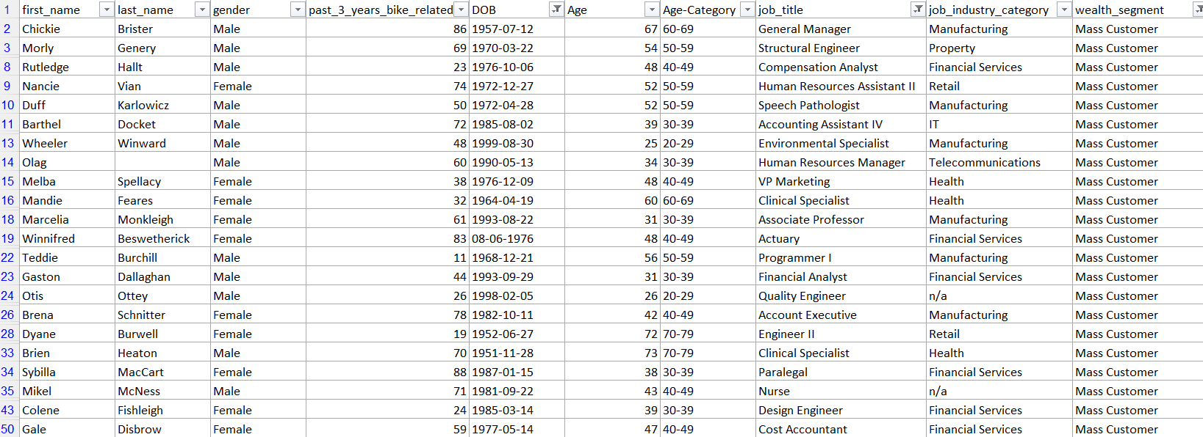
Note: The data and information in this document is reflective of a hypothetical situation and client. This document is to be used for KPMG Virtual Internship purposes only.
Interpretation

Slide 15
Note: The data and information in this document is reflective of a hypothetical situation and client. This document is to be used for KPMG Virtual Internship purposes only.
Thank You

